Slide 1
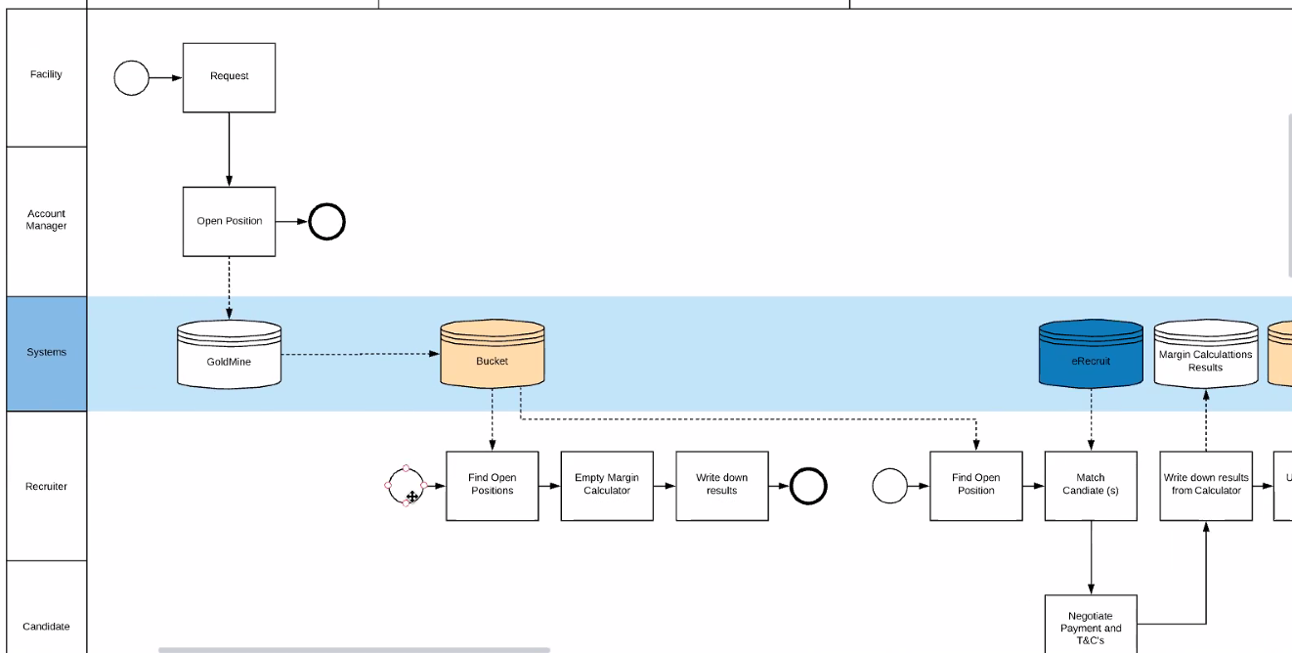
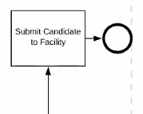
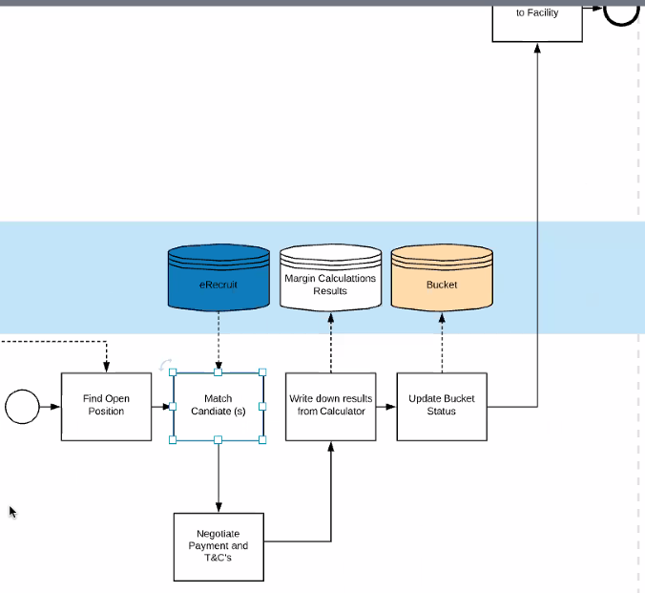
This is just to prepare for the conversation does not save.

Slide 2
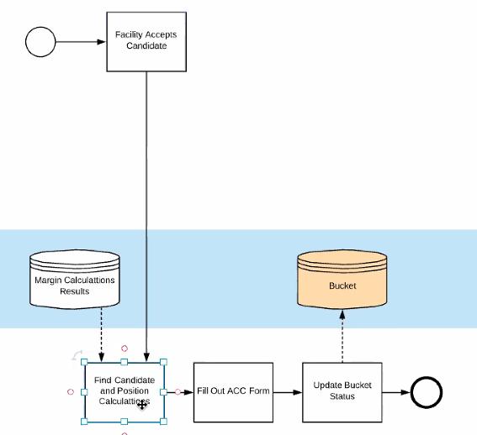
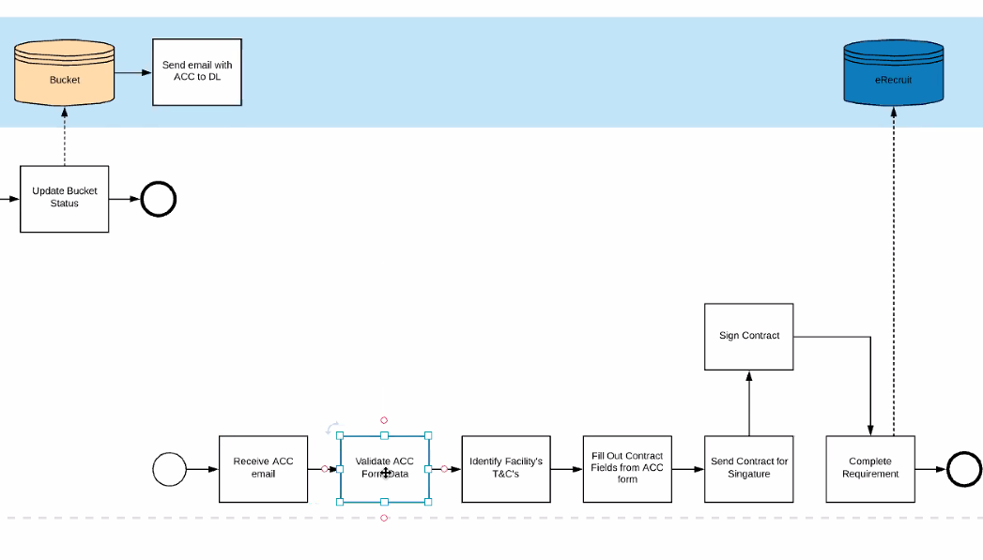

Slide 3
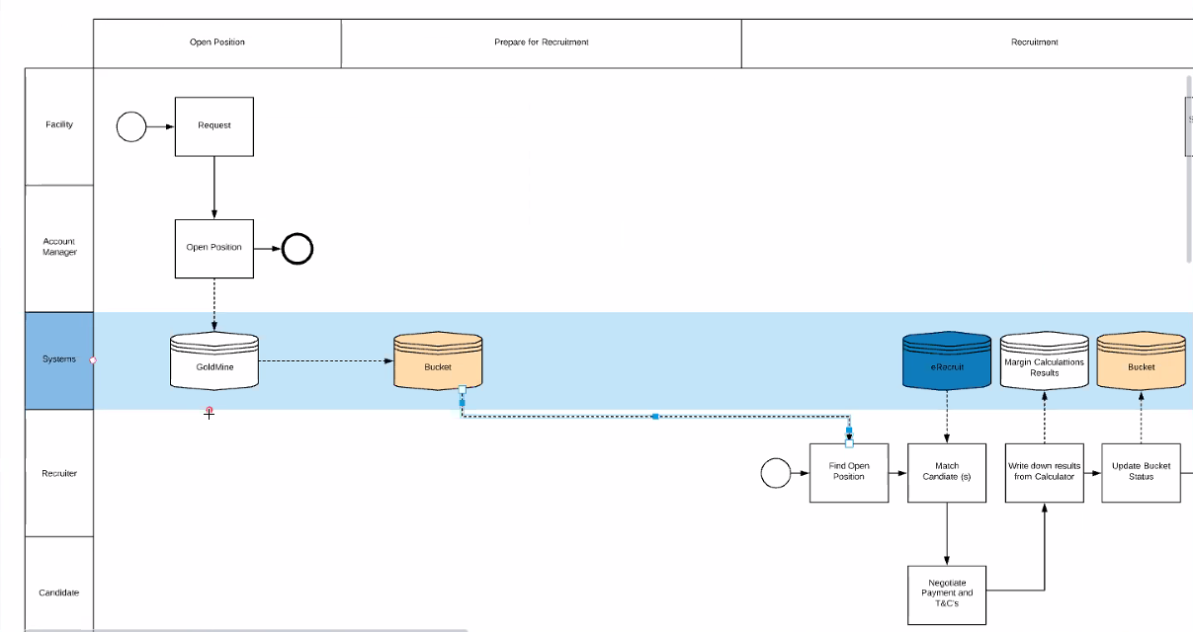
Scenario: I as a Recruiter want to find the position to work with by looking into data in the bucket from gold mine.
Job boards is currently feeding from Gold mine. Still will go to the job board but will open new calculator with position data only.

Slide 4
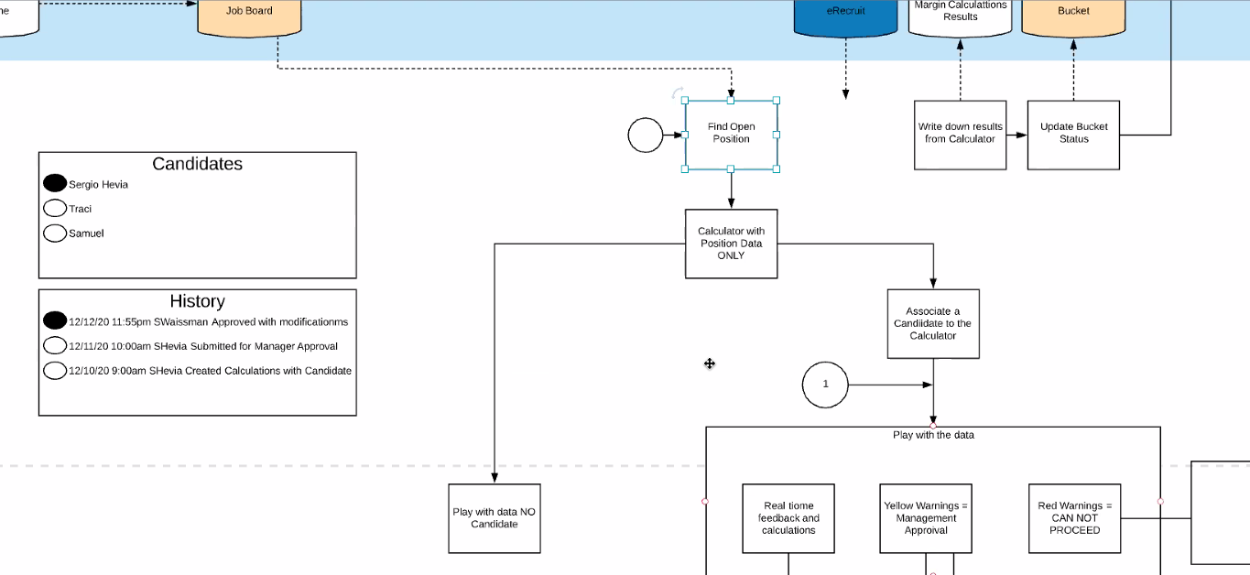

Slide 5
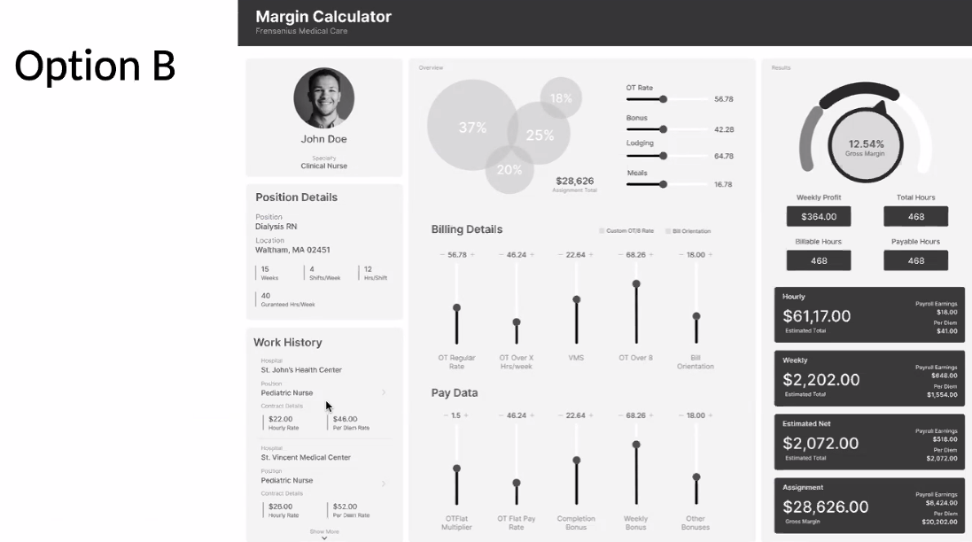
Will open the calculator with Position data but no candidate. (can pull past history from e-recruit on how much was paid in the past)
They can play with the calculator with no candidate.

Slide 9
Will then be able to select the candidate. Once you select the candidate the left column is about the candidate history instead of positions history.
Can play with data and will be real time dynamic.

Slide 10
Save:
Need to be able to save.
When click save there needs to be a unique name.
Candidate/Position/DateTime/Recruiter
Give the user options to name it something else.
Save
Create Template
Submit
Cancel
Create Template:
Allow them to create a template for position and facility.
Submit Candidate:
First save then check for warnings, does it need approval, send if yes send e-mail to manager or If no warnings Update the bucket to submission.
(Will have red and yellow warnings. Red is not possible can not submit, yellow can be submitted to manager.)
Recruiter needs to be able to explain why they are asking for approval
Cancel:
It does not save

Slide 11
Manager gets link in e-mail and click on the link which will open the calculator for candidate and position with the recruiter sent.
Save
Add Notes
Approve
Decline
Cancel
Manager screen
Save:
Manager can make changes and save.
Decline:
Sends e-mail to the recruiter. To stay playing with the data again.
Approved:
It sends an e-mail to the recruiter and will submit. Goes back to the recruiter but is locked down. Recruiter works with candidate if there were changes.
Add Notes:
Notes can be added anytime but force them to add a note.

